Slide 1
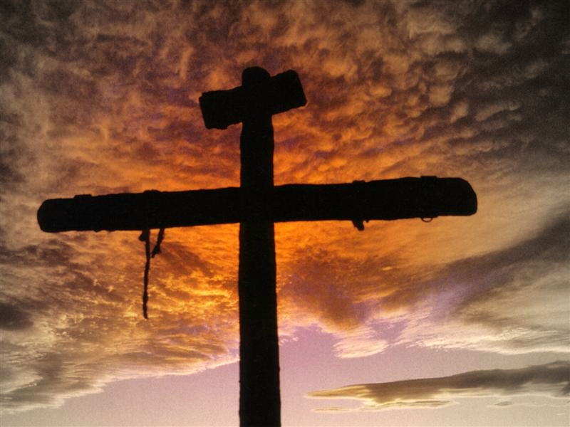
A Cross-Centered
Religion
1 Corinthian 1:18
Notes:
Scripture Reading 1 Corinthians 1:17-31.
Christ has not burdened evangelists to be baptizers (v. 17); our success in the gospel is not measured by the number of baptisms/conversions, but by preaching the gospel. It is in preaching the gospel, that men who want to be saved with good and honest hearts will seek to be baptized into Jesus Christ, for the remission of sins.
Paul speaks of the “message of the cross” (v. 18). It is received upon the ears of men in such opposite ways. For some they deem the message of the cross as foolishness. For others, they deem it as power. Some are lost, some are saved.
What exactly do they judge as foolishness? Was it merely that Jesus died on a cross? No, the cross was well known and well practiced at that time. Was it merely that Jesus died a “martyr” on a cross? No. It wasn’t merely that he died as a martyr, because others had done that during that time and since.
The message of the cross means more than merely preaching that Jesus died on a cross. It entails that He as the Son of God, died and provided the means for atonement for mans’ sins and that reconciliation is only through Him and His covenant (1:30).
We are going to look at what constitutes a “cross-centered religion” today. Now for some, today is considered “Easter” and in such a day they seek to center unto themselves the cross. Is it a cross-centered religion which spends one day a year in honoring the death of Christ? Other churches have sought to attract people to the cross by offering a contemporary worship (instrumental music), a church meal, an espresso, a camping retreat. But these gimmicks do not attract people to the cross, but clutter it with man-made religion and ideas. The cross, in its wisdom and power should become attractive all on its own for those who are serious about the salvation extended from God.
So what does a cross-centered religion emphasize?

Slide 2
Centers On
a cross-centered religion
CONNECTED
CHURCH
The Church
  “Therefore take heed to yourselves and to all the flock, among which the Holy Spirit has made you overseers, to shepherd the church of God which He purchased with His own blood” (Acts 20:28)
    What did He purchase?
    What did He purchase it with?
Notes:
A Cross-Centered Religion is a religion that centers in on the value of the church; its message connects the cross to the church.
Do you see how the church is connected to the cross in this passage?
CLICK X2

Slide 3
Value of the Church to God
He is the Savior of (Eph. 5:23)
His beloved bride (Eph. 5:25)
His body (Eph. 1:22, 23)
His fullness of Him (Eph. 1:23)
Notes:
Fullness – suggests a filling up. When a shipped is filled with sailors and soldiers it is a ship that is ready for whatever may come its way. The church is filled by Christ. There is no other system or society that is said to be the fullness of Christ.
When people diminish the value of the church, they diminish the value of the One who fills it. When one preaches Christ and not the church, his message beheads the body.

Slide 4
Value of the Church to you?
“But seek first the kingdom of God and His righteousness, and all these things shall be added to you” (Matt. 6:33)
A
  ttitude
  ctions
  ttendance
Notes:
What value you place on the church is defined by your actions; your actions define your priorities.
Our attitude, actions throughout the week and attendance are all measuring rods of how much we value the bride of Christ.

Slide 5
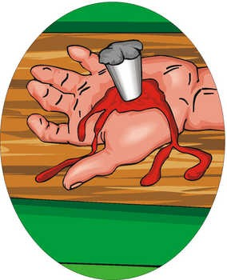
Centers On
a cross-centered religion
“a releasing effected by payment of ransom”
(Online Bible Greek Lexicon)
The Church – Acts 20:28
Redemption
  “In Him we have redemption through His blood, the forgiveness of sins, according to the riches of His grace” (Eph. 1:7)
“after he is sold he may be redeemed again. One of his brothers may redeem him”
(Lev. 25:48)
Notes:
Redemption is the grand theme of the entire Bible and it always requires a cost. The cost here mentioned is “his blood” (cf. 1 Pet. 1:18, 19). There was laid down beforehand of one who was sold who could be redeemed again, by one of his brothers. Jesus essentially became our close kin when he took on the form of a man to redeem us back to God from the slave labor of sin.

Slide 6
Centers On
a cross-centered religion
“a releasing effected by payment of ransom”
(Online Bible Greek Lexicon)
The Church – Acts 20:28
Redemption
  “just as the Son of Man did not come to be served, but to serve, and to give His life a ransom for many” (Matt. 20:28)
“after he is sold he may be redeemed again. One of his brothers may redeem him”
(Lev. 25:48)
Notes:
Antitypically, Jesus became the Son of Man to save man as a near kinsman. Jesus came to do what? He came to serve and to give His life a ransom (payment, etc.).
Usually a ransom is a sum of money, but no money can buy back a soul that has been lost. As life was lost, life must be given to reclaim.

Slide 7

Centers On
a cross-centered religion
The Church – Acts 20:28
Redemption – Eph. 1:7
The Lord’s Supper
  “and when He had given thanks, He broke it and said, ‘Take, eat; this is My body which is broken for you; do this in remembrance of Me.’ In the same manner He also took the cup after supper, saying, ‘This cup is the new covenant in My blood. This do, as often as you drink it, in remembrance of Me.’ For as often as you eat this bread and drink this cup, you proclaim the Lord’s death till He comes” (1 Cor. 11:24-26)
Notes:
It is through this act that we commemorate the crucifixion of our Lord. The world, it seems, while neglecting the church of God’s choice and while neglecting the terms for redemption, will proudly wear crucifixes around their necks to show an outward form of piety.
But God never authorized that as a way to commemorate the death of Christ. Rather, He chose emblems in the unleavened bread and fruit of the vine to be partaken of by men to commune with Christ and His sacrifice.
Do you see how the Lord's Supper is centered upon the cross? What do we proclaim in this act?

Slide 8
When Early Christians Met to Partake of the Lord’s Supper…
“And they continued steadfastly in the apostles’ doctrine and fellowship, in the breaking of bread, and in prayers” (Acts 2:42)
“Now on the first day of the week, when the disciples came together to break bread, Paul, ready to depart the next day, spoke to them and continued his message until midnight” (Acts 20:7)
Notes:
{CLICK X 3} Note some similarities. They continued in the apostles' doctrine in Acts 2. Yet at the Troas-meeting, Paul an apostle was there preaching the pure doctrine of Christ and even continued his message until midnight.
[CLICK X4] Note, they continued in the breaking of bread. This is hardly a picture of doing it once every quarter or year. They did it every first day of the week as Paul gives us an inspired stamp of approval on their meeting. Note: when did the disciples come together? What did they come together to do?

Slide 9
monthly, quarterly, yearly?
Is A Church That Only Partakes Of The Lord’s Supper Once In A While Centered On The Cross!

Slide 10
Centers On
a cross-centered religion
The Church – Acts 20:28
Redemption – Eph. 1:7
The Lord’s Supper – 1 Cor. 11:24-26
The Separation of Covenants
  “then He said, ‘Behold, I have come to do Your will, O God.’ He takes away the first that He may establish the second. By that will we have been sanctified through the offering of the body of Jesus Christ once for all” (Heb. 10:9, 10)
1st Cov. was given by Moses (Heb. 9:1-4, 18-20)
Notes:
Recall “new covenant” (1 Cor. 11:25). Notice, he takes away the first in order to establish the second. Something is taken away and something is established. Notice that something is taken away and established through the offering. Hence, the offering of Jesus on the cross draws our minds to know that the first covenant was taken away and a new covenant was given.
I want you to understand that there is a 1st Cov. and a second covenant. The first was given by Moses (Heb. 9:1-4, 18-20). The second was given by Christ.

Slide 11
Hebrews 10:9, 10
what was taken away?
what is established?
by what will are we sanctified through the body of Christ today?
Taken away | 1st
 | 2nd
Established | 1st
 | 2nd
Sanctified through cross | 1st
 | 2nd
Notes:
Click thru. . .

Slide 12
Hebrews 9:15-17
¹⁵ And for this reason He is the Mediator of the new covenant, by means of death, for the redemption of the transgressions under the first covenant, that those who are called may receive the promise of the eternal inheritance.
¹⁶ For where there is a testament, there must also of necessity be the death of the testator.
¹⁷ For a testament is in force after men are dead, since it has no power at all while the testator lives.
cf. Hebrews 8:13
Notes:
[CLICK] There is something called a “new covenant” and the very calling of it as “new” necessitates that some covenant before it was made old (Heb. 8:13).
We also note here that a testament requires the death of the testator for it to be in force. So this passage clearly shows when the 1st covenant was dissolved. It was dissolved at the death of the Christ.
After Jesus died, His new testament came in force. Since the new cannot coexist with the first covenant it requires that the cross not only established the new covenant, but took away the first.

Slide 13
Summary of Facts of the 1st
What was in the 1st Covenant?
  The 1st Cov. contained the law, tabernacle, ark of the covenant, animal sacrifices, tablets of stone, etc. (Heb. 9:1ff)
When was the first Covenant made
  By Moses on Mount Sinai/Horeb
  “Nothing was in the ark except the two tablets which Moses put there at Horeb, when the LORD made a covenant with the children of Israel, when they had come out of Egypt” (2 Chron. 5:10)
Notes:
[CLICK X5] When did the Lord make a covenant with the children of Israel? When they had come out of Egypt.
Where did God make this covenant? Horeb. There is not a covenant made with the children of Israel before this time; there was not a covenant made with the children of Israel after this time except the New Covenant that came through Jesus.

Slide 14
Summary of Facts of the 1st
What was in the 1st Covenant?
  The 1st Cov. contained the law, tabernacle, ark of the covenant, animal sacrifices, tablets of stone, etc. (Heb. 9:1ff)
When was the first Covenant made
  By Moses on Mount Sinai/Horeb (2 Chron. 5:10)
Who took it away?
  Christ (Heb. 10:9, 10; cf. Col. 2:14-17; Eph. 2:15)
When was it taken away?
  When Christ died on the Cross (Heb. 9:15-17)

Slide 15
Colossians 2:14-17
¹⁴ having wiped out the handwriting of requirements that was against us, which was contrary to us. And He has taken it out of the way, having nailed it to the cross.
¹⁵ Having disarmed principalities and powers, He made a public spectacle of them, triumphing over them in it.
¹⁶ So let no one judge you in food or in drink, or regarding a festival or a new moon or sabbaths,
Notes:
The handwriting of requirements is referring to that 1st covenant that contained the Sabbath, monthly, and yearly feasts. What happened to it? It was nailed to the cross. It was taken out of the way. Who took it out of the way? Jesus who died on the cross!

Slide 16
A Church
that doesn’t emphasize the separation of covenants is not a cross-centered church
that emphasizes Sabbath-keeping is not a cross-centered church
Notes:
A church that teaches that the first-covenant started at creation denies explicit statements of scripture as to when the first covenant was given (1 Kin. 8:9; 2 Chron. 5:10; Deut. 5:2, 3; Jer. 31:31-34

Slide 17
Centers On
a cross-centered religion
The Church – Acts 20:28
Redemption – Eph. 1:7
The Lord’s Supper – 1 Cor. 11:24-26
The Separation of Covenants – Heb. 10:9, 10
The Love & wrath of God – Jn. 3:16
Notes:
Click next chart for verse

Slide 18
John 3:16
“For God so loved the world that He gave His only begotten Son, that whoever believes in Him should not perish but have everlasting life.”
“Therefore consider the goodness and severity of God…” (Rom. 11:22)
Notes:
Notice that this verse speaks of the greatest love as well as the greatest punishment “perish.” Many emphasize the former and neglect the latter. But the love of God who spared not His Son was for something other than just dying because it was something to do. It was to spare us from a place of perishing. The cross was endured to spare us from hell.
Any church that doesn’t emphasize the love and wrath of God is not a cross-centered church. Do you see how the place of perishing and the place of life are somehow connected to the cross?

Slide 19
Centers On
a cross-centered religion
The Church – Acts 20:28
Redemption – Eph. 1:7
The Lord’s Supper – 1 Cor. 11:24-26
The Separation of Covenants – Heb. 10:9, 10
The Love & wrath of God – Jn. 3:16
Salvation – Heb. 9:27, 28

Slide 20
Hebrews 9:27, 28
²⁷ And as it is appointed for men to die once, but after this the judgment,
²⁸ so Christ was offered once to bear the sins of many. To those who eagerly wait for Him He will appear a second time, apart from sin, for salvation.
Notes:
The meaning of this verse is clear. Jesus was offered once to bear the sins of many. He died to save us from sins. Salvation is cross-centered. Jesus will come a second time, not to die for man’s sin, but to reward salvation.
Do you see how Christ's death is connected with His return and the subsequent salvation?
Any church that doesn’t teach the Lord’s plan for salvation is not a cross-centered church.

Slide 21
Jesus Died on the Cross so WHO Could Be Saved?
For those who believe (Jn. 3:16)
For those who repent (Acts 17:30, 31)
For those who confess (Rom. 10:9, 10)
For those who are baptized (Mk. 16:16)
HAVE YOU DONE
THESE?
DO YOU HAVE A CROSS-CENTERED RELIGION?

